Slide 1
2016 Nonroad Collaborative Work Group
1 November 2018
Local Conference Lines:
EPA Region 1 (Boston): 857-702-8290 EPA Region 2 (NYC): 347-384-7287
EPA Region 3 (Philadelphia): 484-352-3221 EPA Region 4 (Atlanta): 470-705-2279
EPA Region 5 (Chicago): 312-667-7115 EPA Region 6 (Dallas): 469-250-2701
EPA Region 7 (Kansas City): 913-608-8349 EPA Region 8 (Denver): 720-642-6536
EPA Region 9 (San Francisco): 628-246-1294 EPA Region 10 (Seattle): 206-800-4483
EPA RTP (Raleigh): 984-444-7480 Main line: 202-991-0477
Conference ID: 6926578

Slide 2
Meeting Agenda
Nonroad 2016 beta inventory
County-level comparisons of alpha and beta inventories
Nonroad 2016 v1 inventory
v1 timeline
Progress in Updating Geographic Allocations: Agriculture, Lawn & Garden, Recreational, Construction
Mark Janssen presentation
Other business

Slide 3
Nonroad beta inventory
EPA has compiled the 2016 beta nonroad inventory; 2023 and 2028 runs have been initiated
Following slides show maps of county-level differences between 2016 alpha and beta inventories
2016 alpha inventory: MOVES2014a with state-supplied data used in the 2014 NEI
2016 beta inventory: MOVES2014b with model defaults (no state-supplied data)
NOx emissions are presented here; additional maps by pollutant (CO, NH3, PM10, PM2.5, SO2, and VOC) are posted on the Inventory Collaborative Google Drive. For each pollutant and equipment category, four maps are provided:
Output from the 2016 alpha inventory (map suffix “_2016fe”)
Output from the 2016 beta inventory (map suffix “_2016ff”)
Difference in tons between the beta and alpha inventories (map suffix “_2016ff_minus_2016fe”)
Percent difference between the beta and alpha inventories (map suffix “_2016ff_minus_2016fe_percent”)
Summary file comparing alpha and beta runs by state-SCC and by county also posted on Google Drive (“2016 beta nonroad comparison.xlsx”)
Notes/Reminders:
Results do not include California, Ground Support Equipment, or Oil Field Equipment
Technical reports describing the nonroad updates in MOVES2014b are posted on the MOVES website

Slide 4
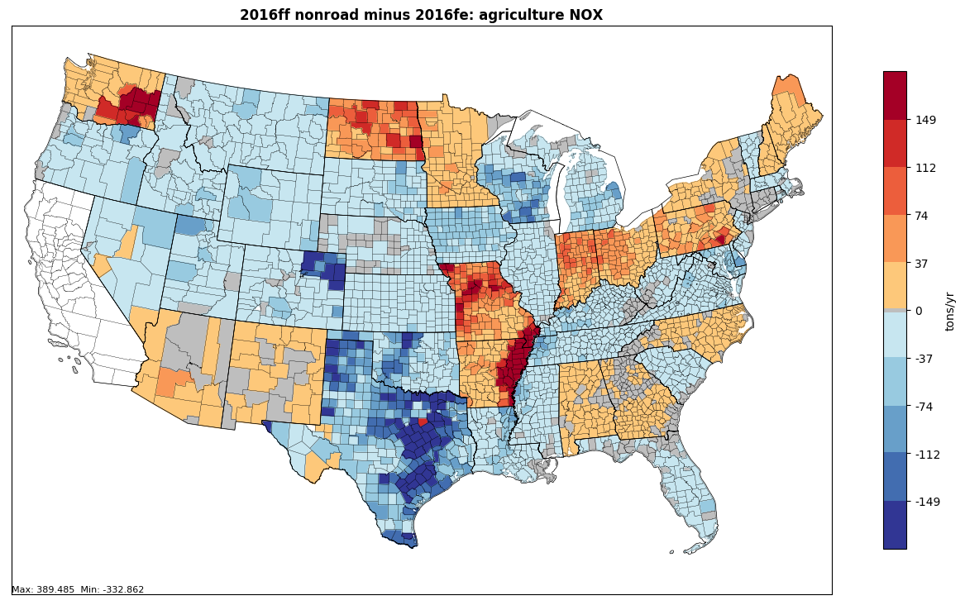
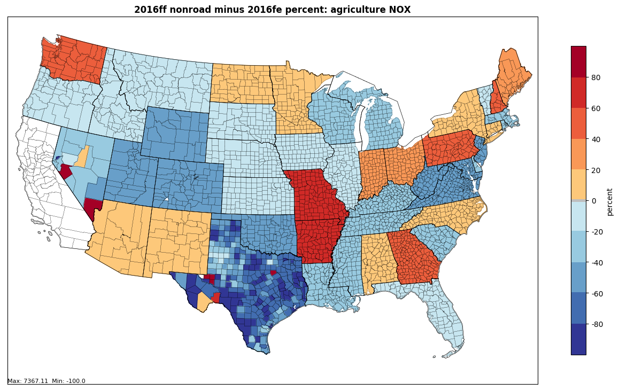
2016 beta inventory: Agricultural Equipment
All SCCs: -6.17% difference

Slide 5
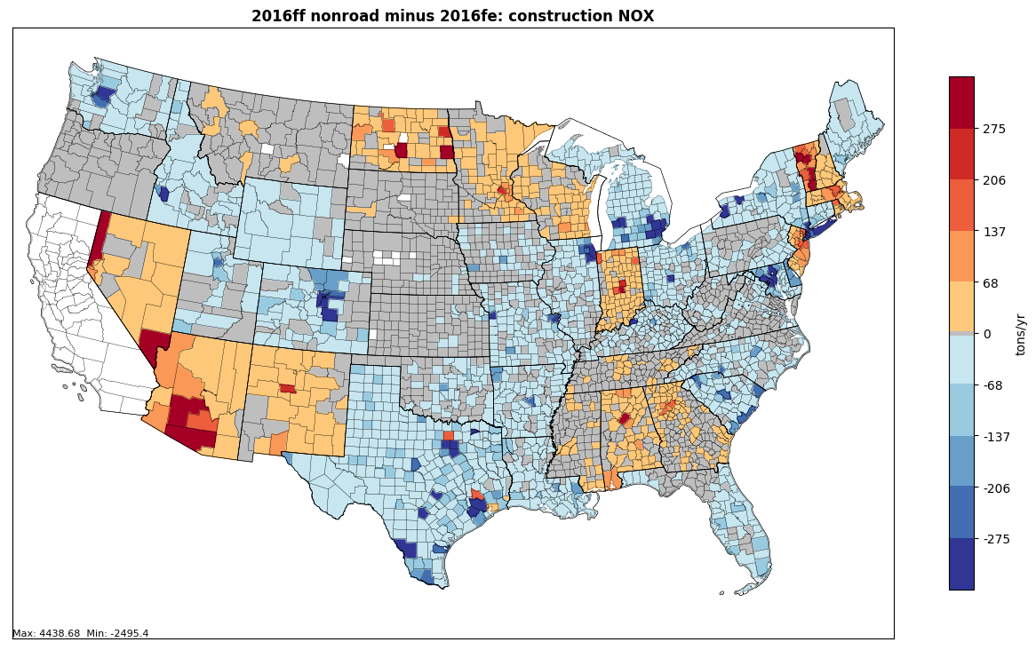
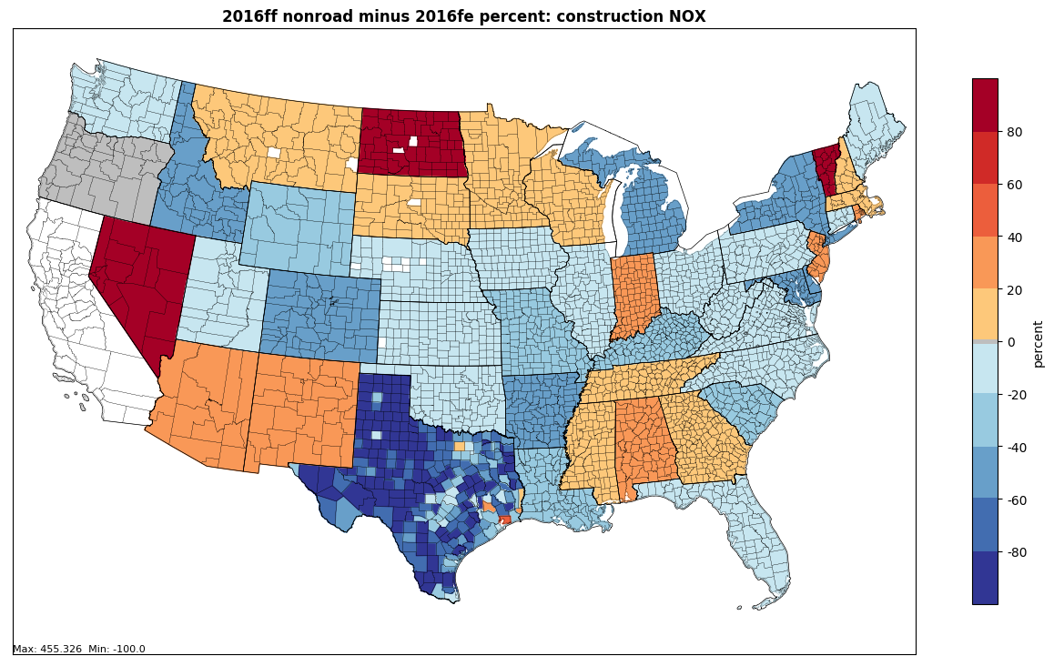
2016 beta inventory: Construction Equipment
All SCCs: -10.42% difference

Slide 6
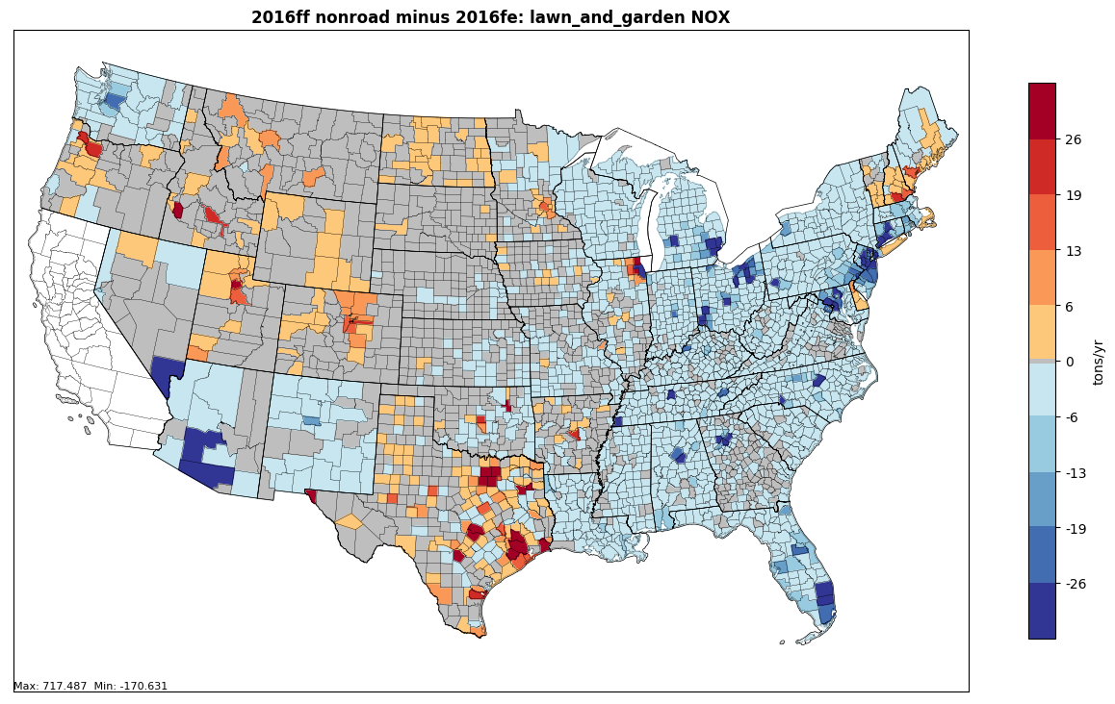
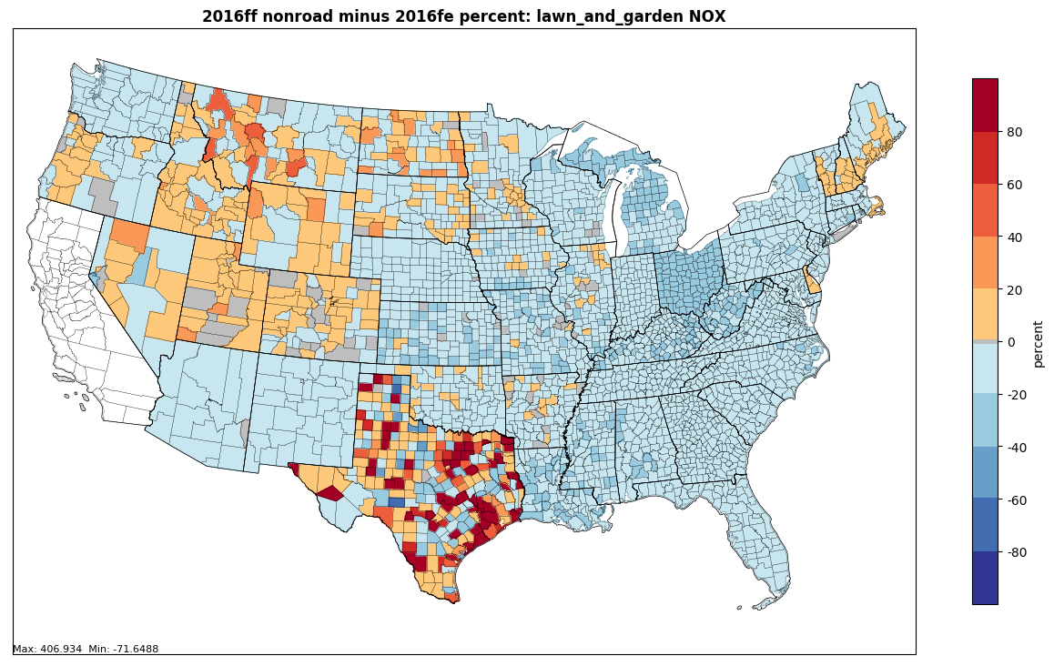
2016 beta inventory: Lawn & Garden Equipment
All SCCs: -2.21% difference

Slide 7
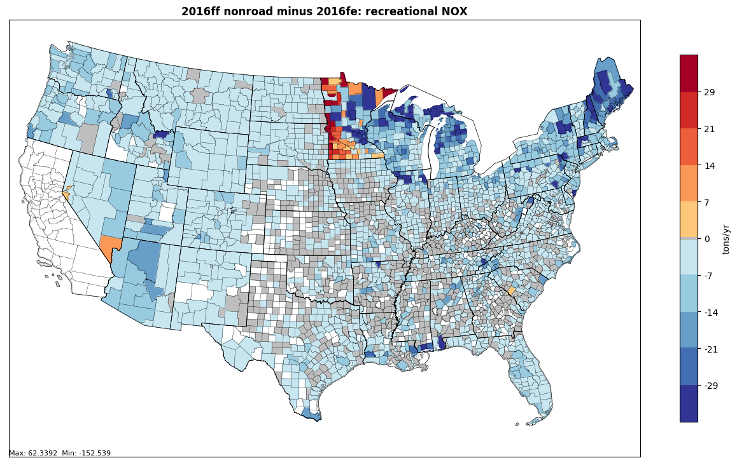
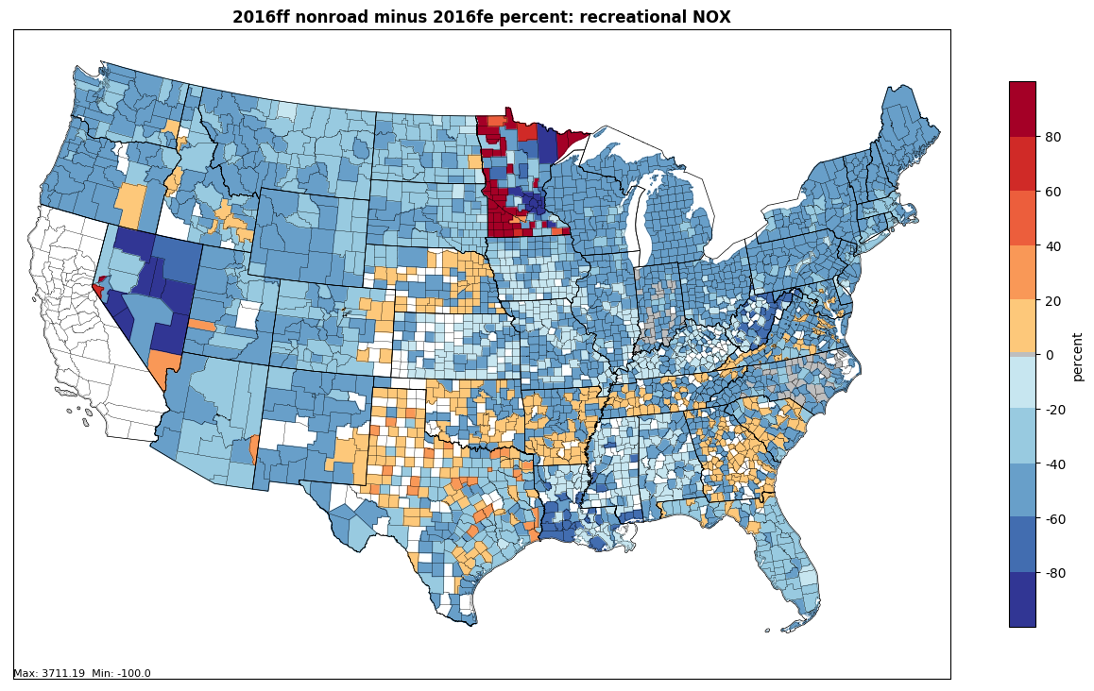
2016 beta inventory: Recreational Equipment
All SCCs: -42.01% difference

Slide 8
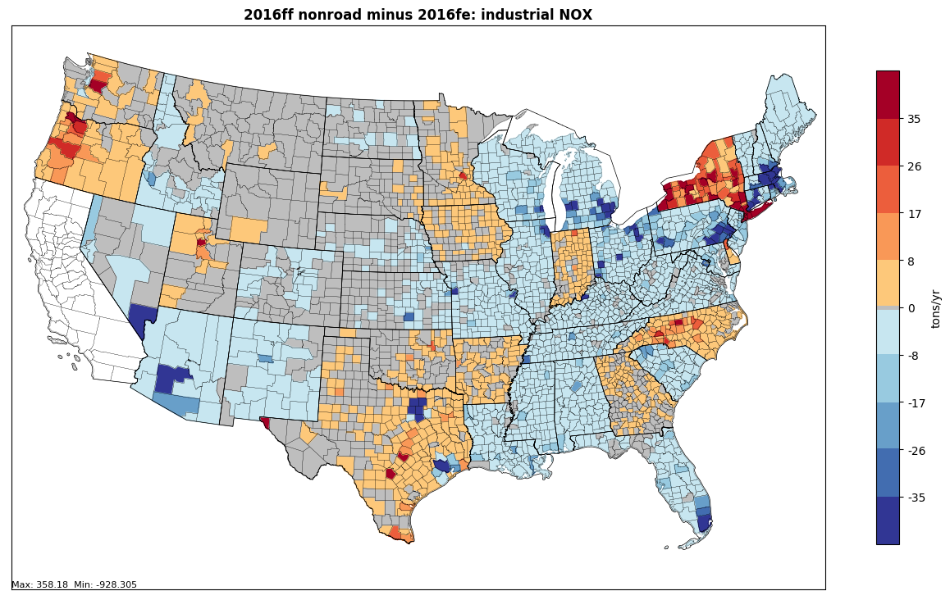
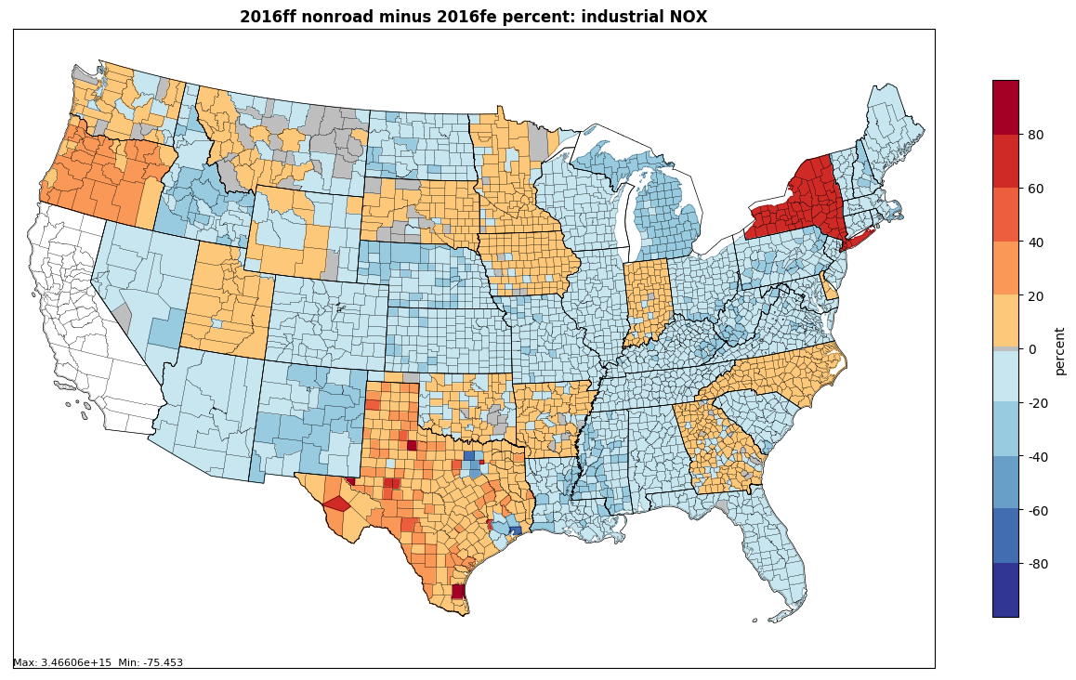
2016 beta inventory: Industrial Equipment
All SCCs: -4.26% difference

Slide 9
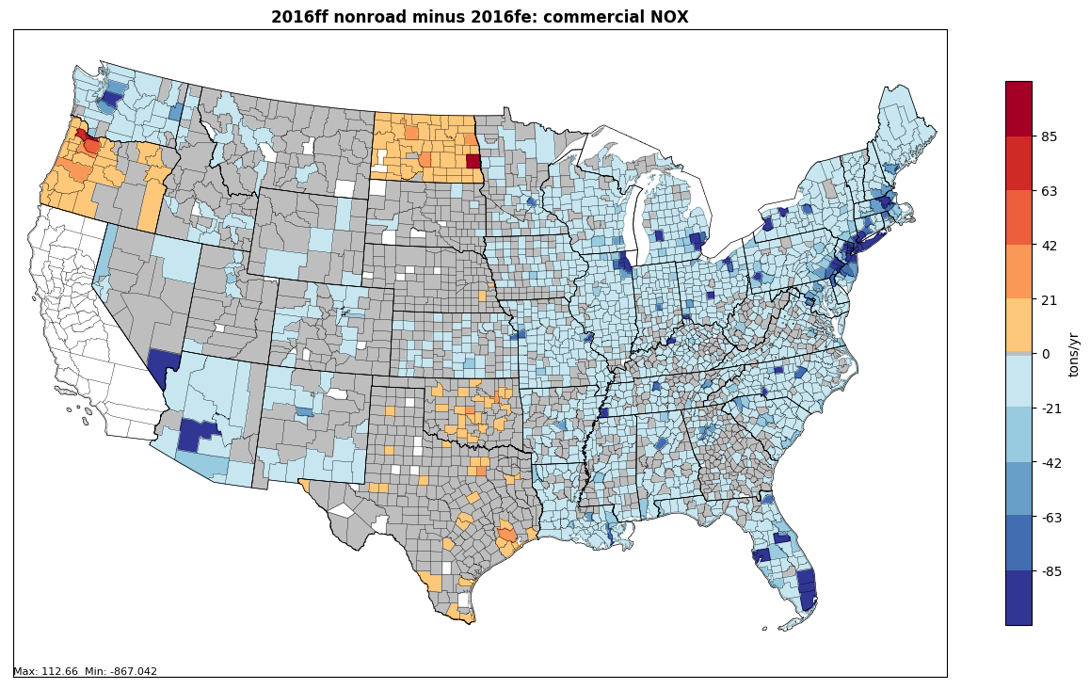
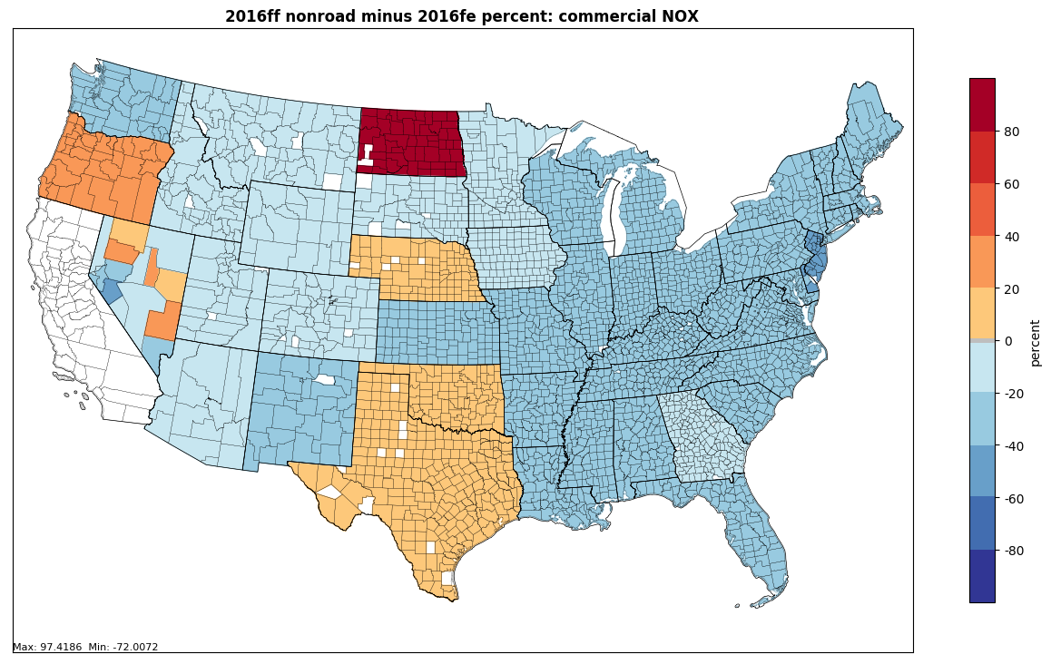
2016 beta inventory: Commercial Equipment
All SCCs: -22.38% difference

Slide 10
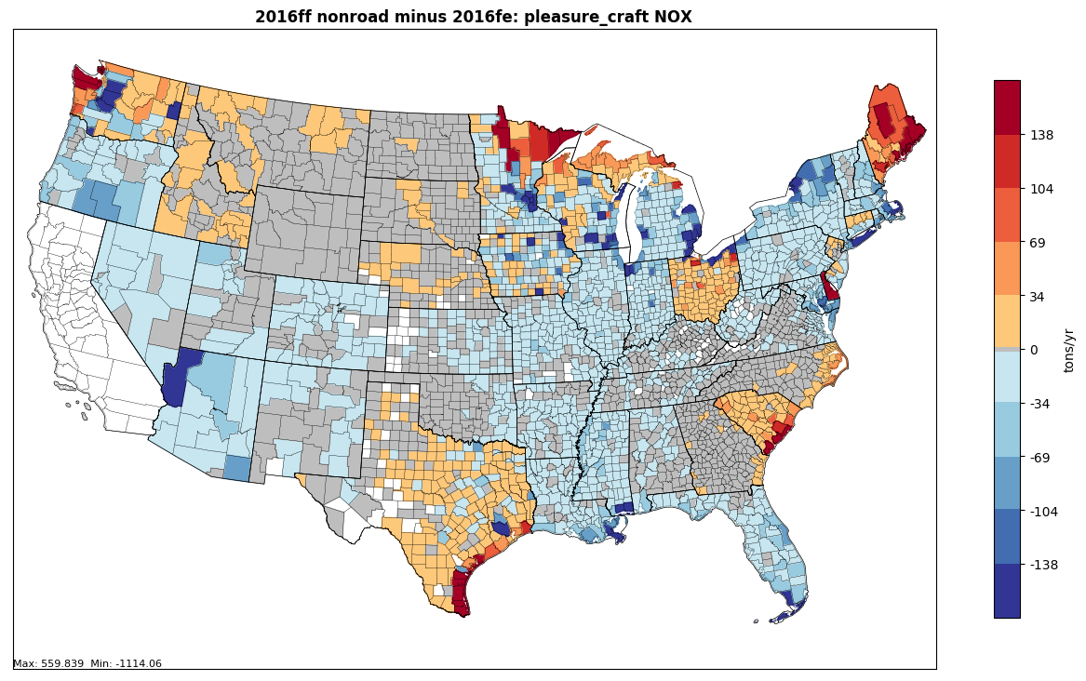
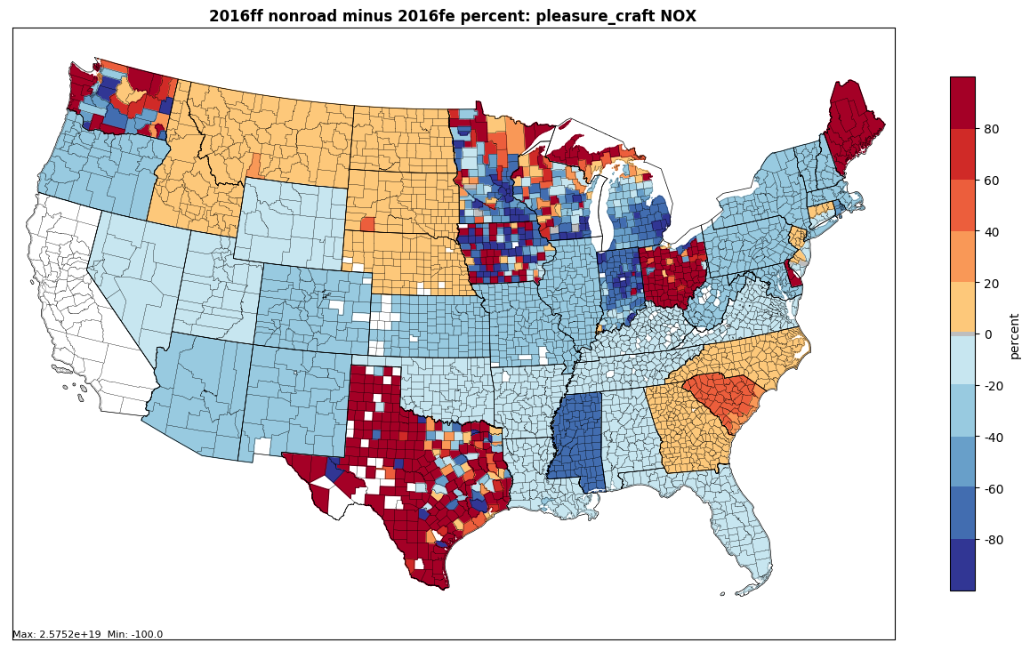
2016 beta inventory: Pleasure Craft
All SCCs: -15.49% difference

Slide 11
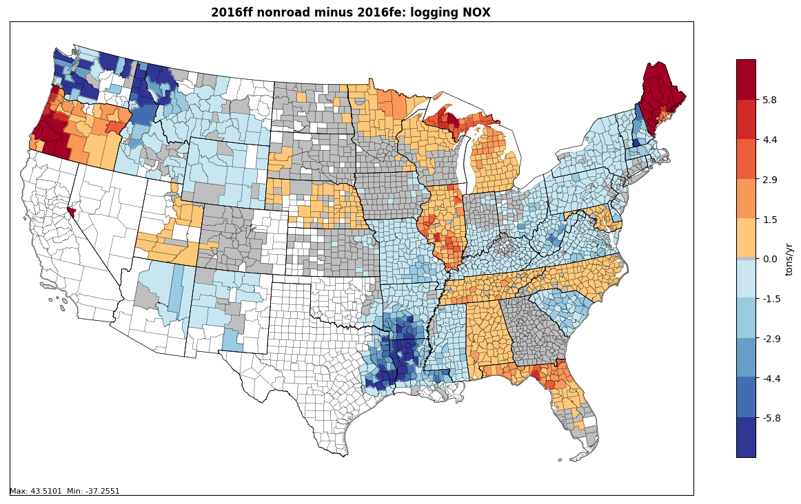
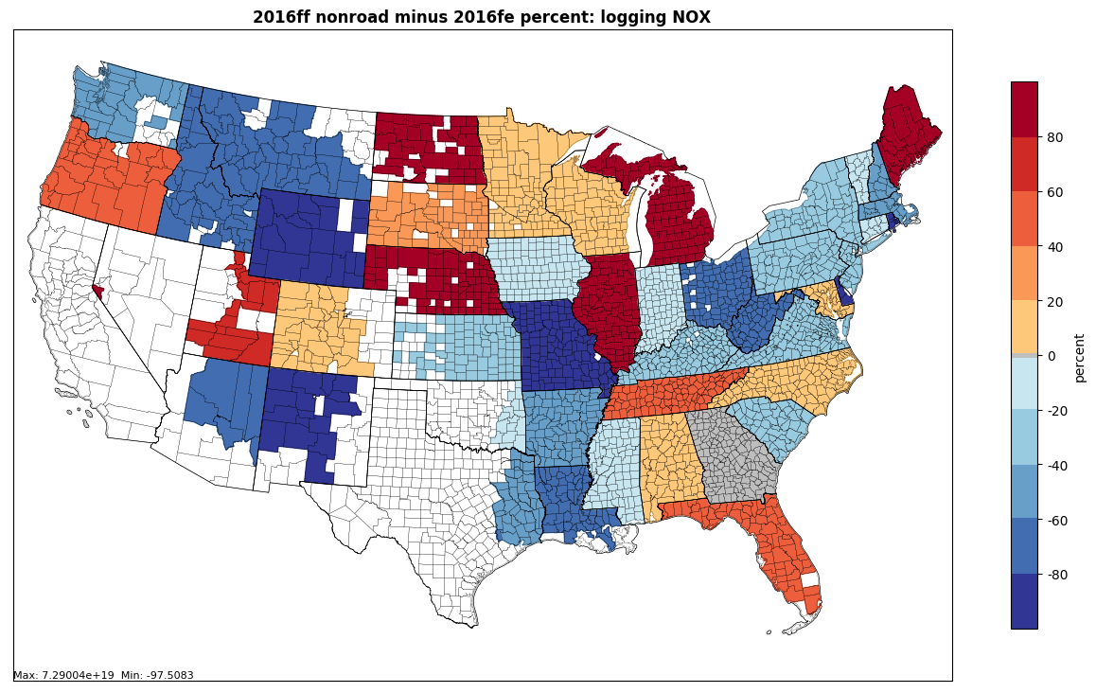
2016 beta inventory: Logging Equipment
All SCCs: -6.78% difference

Slide 12
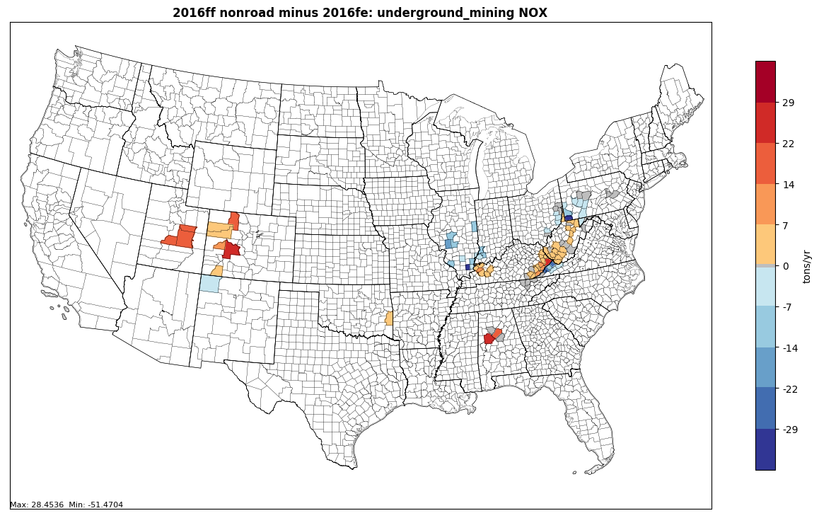
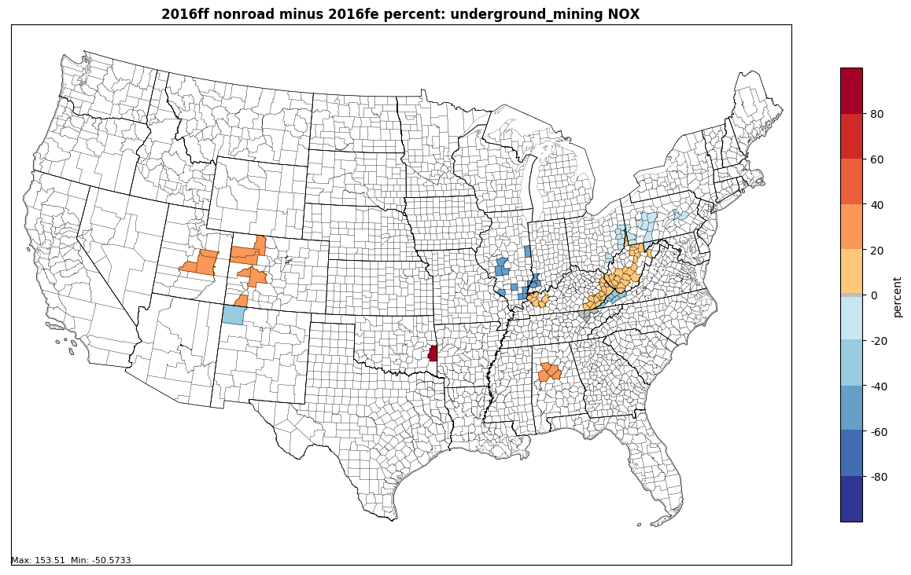
2016 beta inventory: Underground Mining Equipment
All SCCs: +1.07% difference

Slide 13
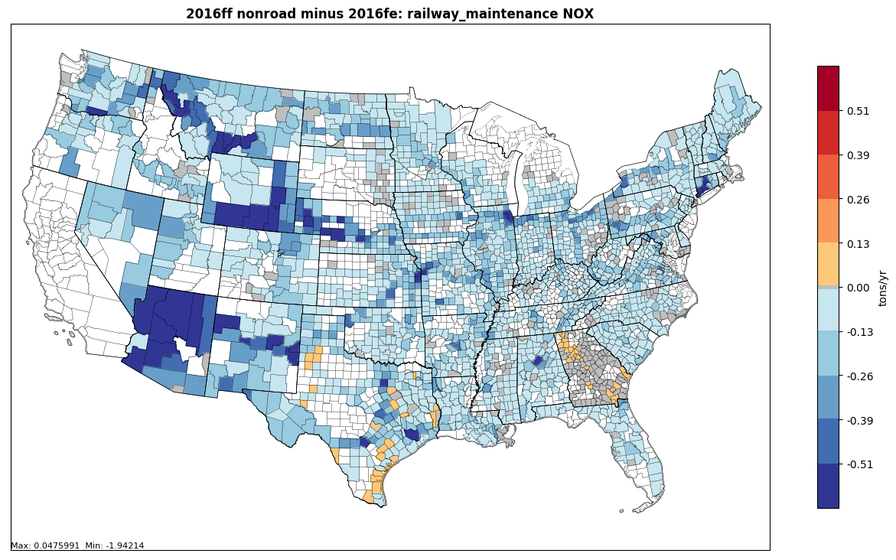
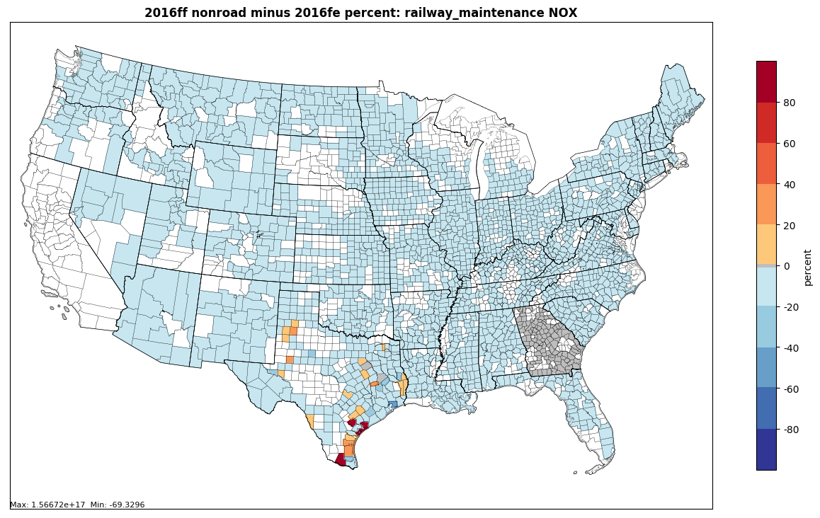
2016 beta inventory: Railway Maintenance Equipment
All SCCs: -10.18% difference

Slide 14
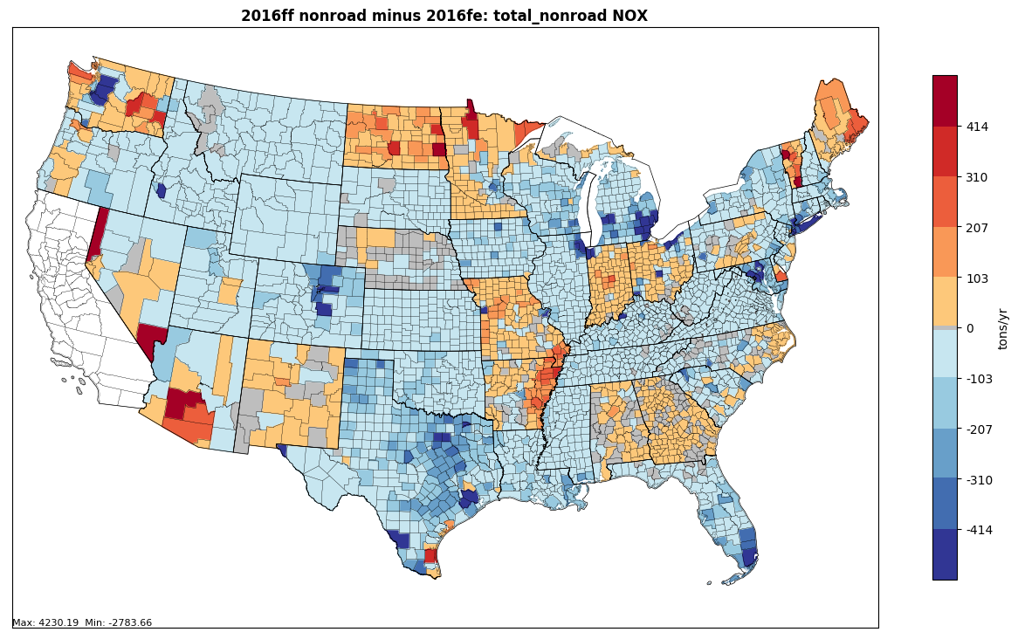
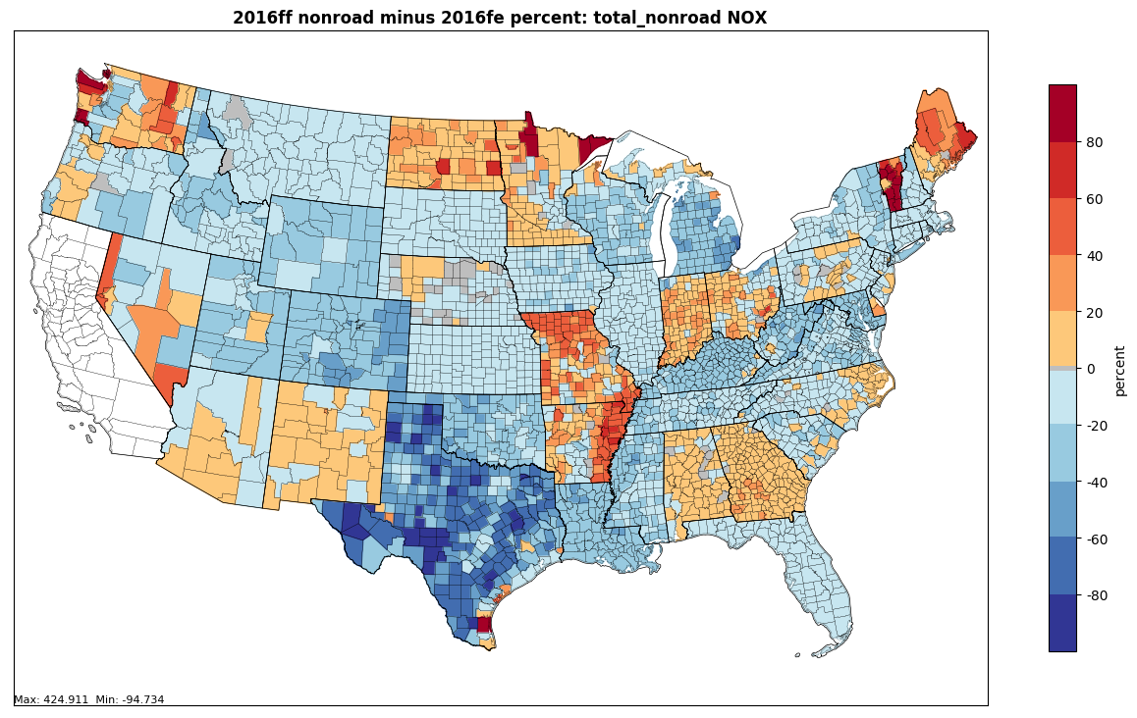
2016 beta inventory: Total Nonroad
All SCCs: -10.31% difference

Slide 15
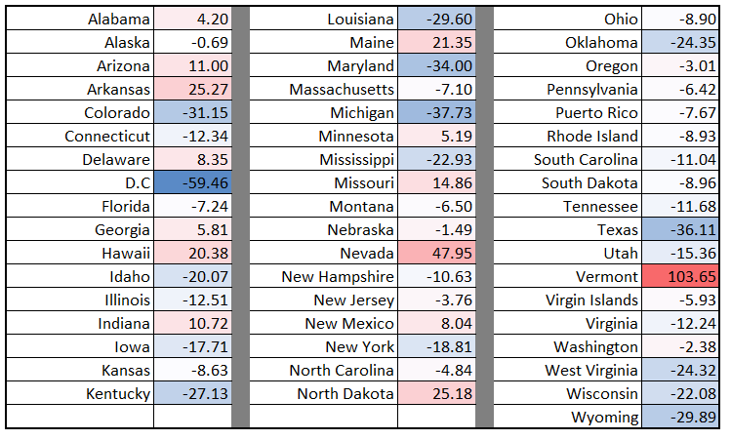
2016 beta inventory: Total Nonroad
Percent increase/decrease in nonroad NOx emissions (beta-alpha) by State

Slide 16
Nonroad v1 inventory
v1 Timeline
EPA planning to kick-off v1 model runs at the end of February
States planning to submit data should do so by January 15th
Submissions should be sent to Sarah Roberts and Alison Eyth
Work group’s geographic allocation updates should also be completed by January 15th
Progress in Updating Geographic Allocations
Agriculture
Lawn & Garden
Recreational
Construction

Slide 17
Other Business / Reminders
Questions and Discussion
Work Group meeting minutes and related files and links available on Work Group wiki:
http://views.cira.colostate.edu/wiki/wiki/9179
Larger data files on Work Group Google Drive: https://drive.google.com/drive/folders/1Q3s1bqTXt3w2LAd5h-nJeUyMNnHnKjBy
Next meeting: November 29th @ 3:30pm EST
December meeting falls on December 27th. Move back one week to January 3rd?

